Slide 1

Data Abstraction & Problem Solving with C++: Walls and Mirrors
Seventh Edition
Chapter 19
Balanced Search Trees
Copyright © 2017, 2013, 2007 Pearson Education, Inc. All Rights Reserved
Notes:
If this PowerPoint presentation contains mathematical equations, you may need to check that your computer has the following installed:
1) MathType Plugin
2) Math Player (free versions available)
3) NVDA Reader (free versions available)

Slide 2
Balanced Search Trees (1 of 2)
Height of binary search tree
Sensitive to order of additions and removals
Various search trees can retain balance
Despite additions and removals

Slide 3
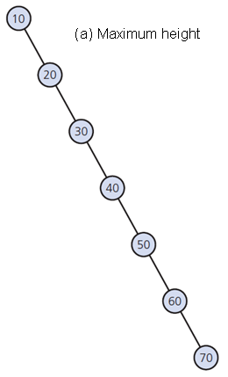
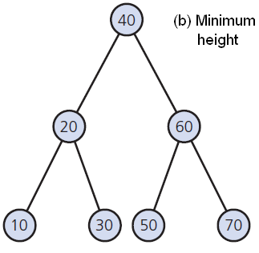
Balanced Search Trees (2 of 2)
Figure 19-1 The tallest and shortest binary search trees containing the same data

Slide 4
A V L Trees (1 of 8)
An A V L tree
A balanced binary search tree
Maintains its height close to the minimum
Rotations restore the balance

Slide 5
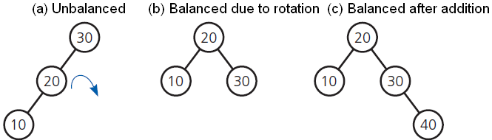
A V L Trees (2 of 8)
Figure 19-2 An unbalanced binary search tree

Slide 6
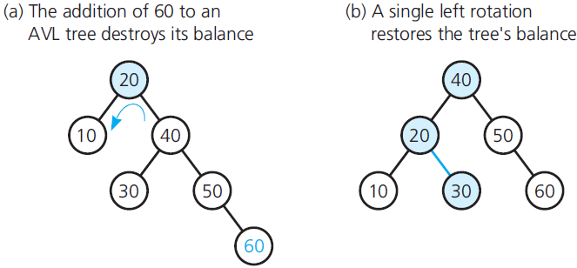
A V L Trees (3 of 8)
Figure 19-3 Correcting an imbalance in an A V L tree due to an addition by using a single rotation to the left

Slide 7
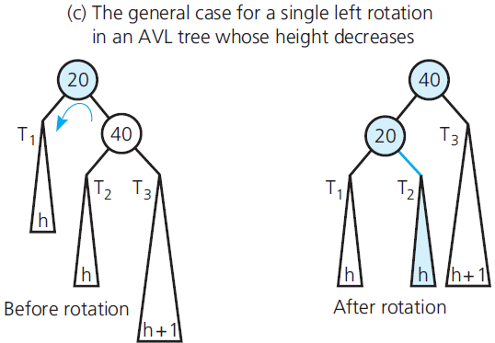
A V L Trees (4 of 8)
Figure 19-3 [Continued]

Slide 8
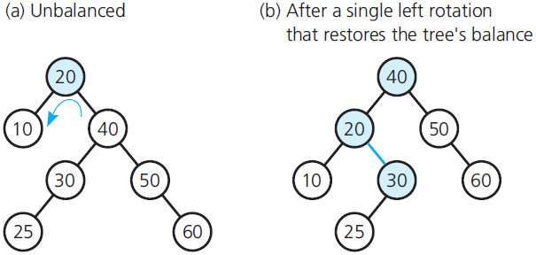
A V L Trees (5 of 8)
Figure 19-4 A single rotation to the left that does not affect the height of an A V L tree

Slide 9
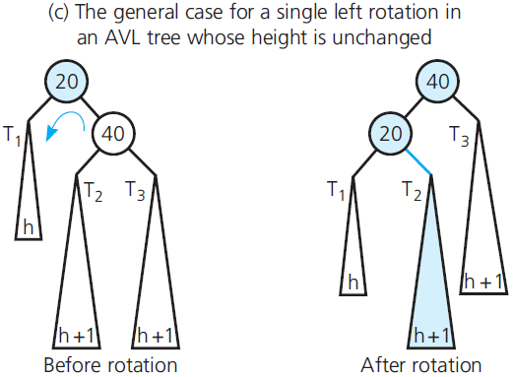
A V L Trees (6 of 8)
Figure 19-4 [Continued]

Slide 10
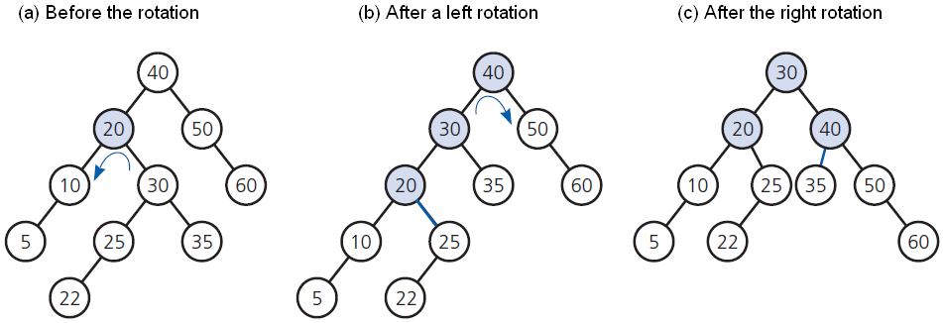
A V L Trees (7 of 8)
Figure 19-5 A double rotation that decreases the height of an A V L tree

Slide 11
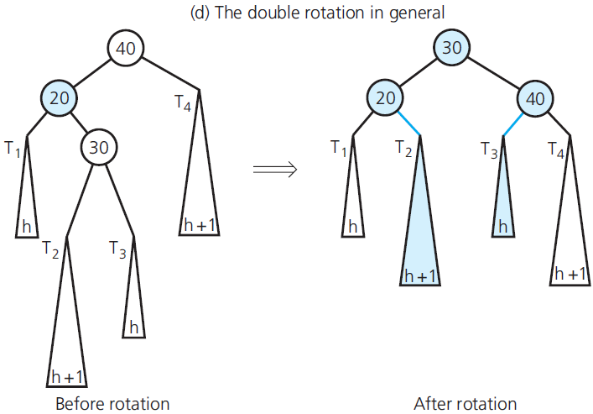
A V L Trees (8 of 8)
Figure 19-5 [Continued]

Slide 12
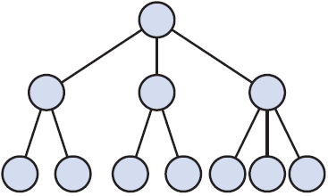
2-3 Trees (1 of 5)
Figure 19-6 A 2-3 tree of height 3

Slide 13
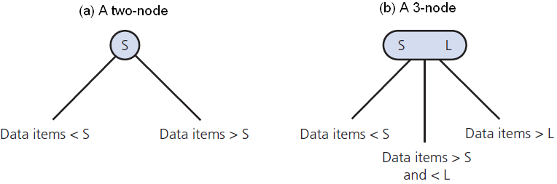
2-3 Trees (2 of 5)
Figure 19-7 Nodes in a 2-3 tree

Slide 14
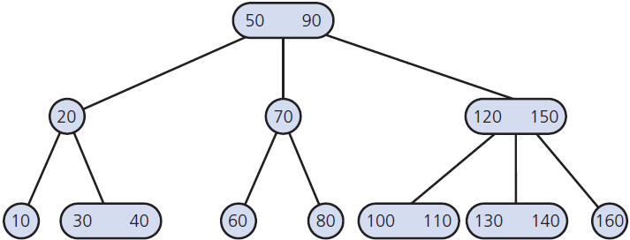
2-3 Trees (3 of 5)
Figure 19-8 A 2-3 tree

Slide 15
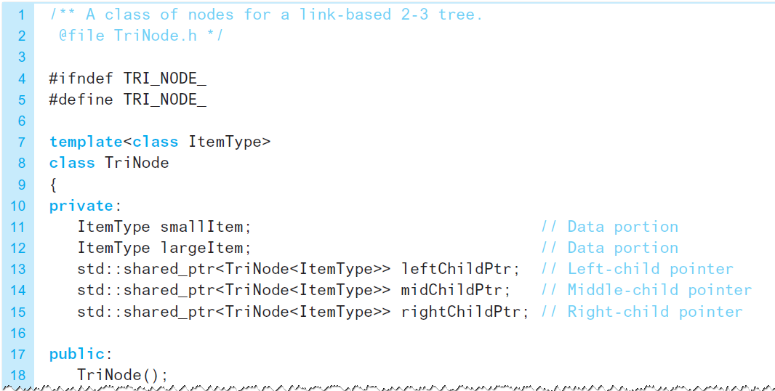
2-3 Trees (4 of 5)
Listing 19-1 A header file for a class of nodes for a 2-3 tree

Slide 16
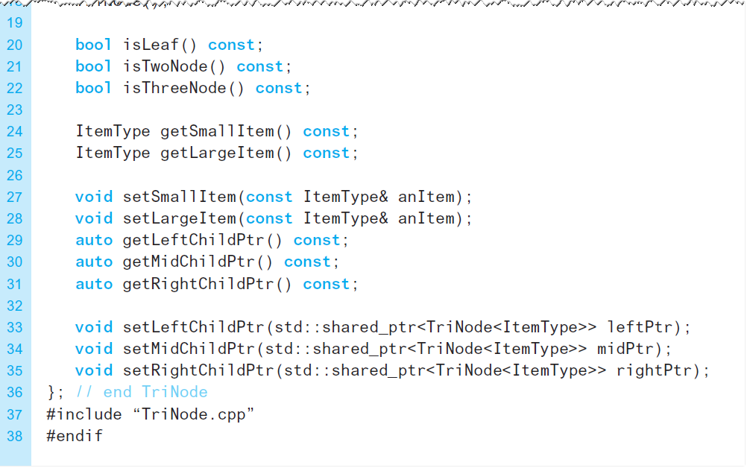
2-3 Trees (5 of 5)
Listing 19-1 [Continued]

Slide 17
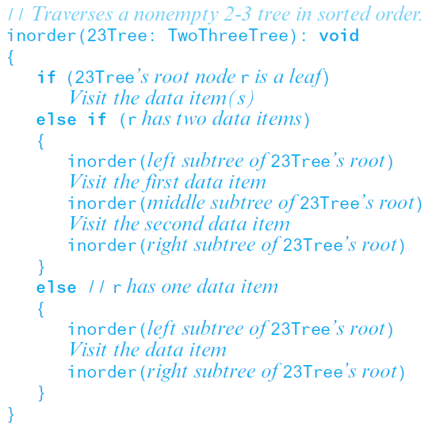
Traversing a 2-3 Tree
Performing the analogue of an inorder traversal on a binary tree:

Slide 18
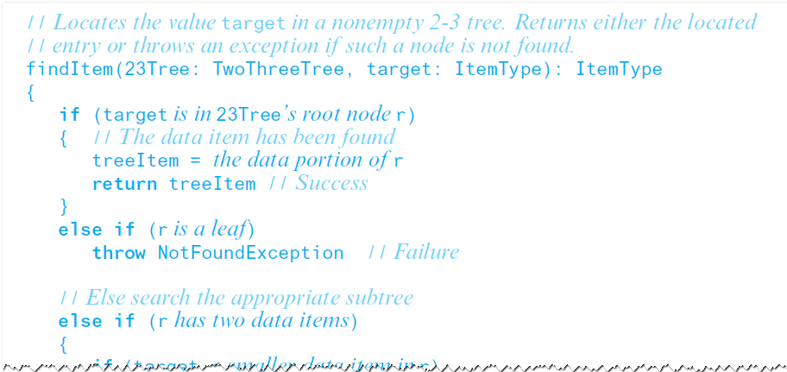
Searching a 2-3 Tree (1 of 5)
Retrieval operation for a 2-3 tree

Slide 19
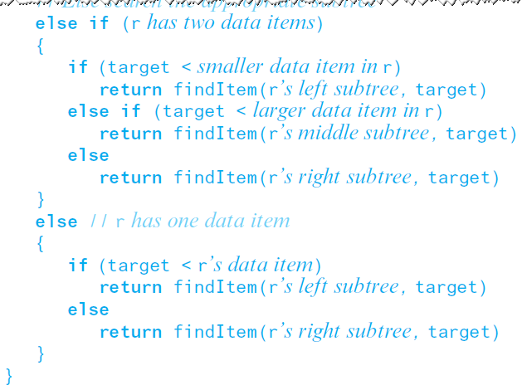
Searching a 2-3 Tree (2 of 5)
Retrieval operation for a 2-3 tree

Slide 20
Searching a 2-3 Tree (3 of 5)
Search of a 2-3 and shortest binary search tree approximately same efficiency
A binary search tree with n nodes cannot be shorter than log₂(n + 1)
A 2-3 tree with n nodes cannot be taller than log₂(n + 1)
Node in a 2-3 tree has at most two data items
Searching 2-3 tree is O(log n)

Slide 21
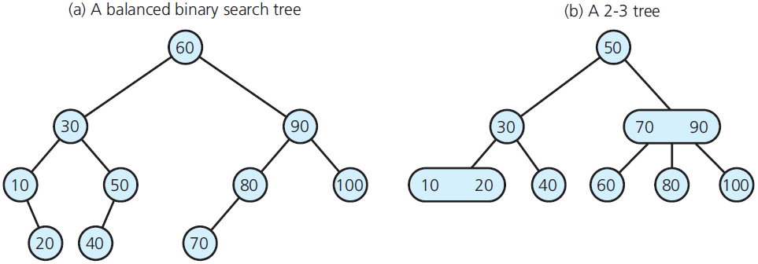
Searching a 2-3 Tree (4 of 5)
Figure 19-9 A balanced binary search tree

Slide 22
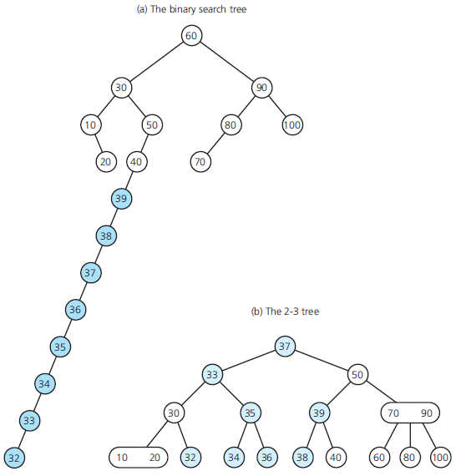
Searching a 2-3 Tree (5 of 5)
Figure 19-10 The trees of Figure 19-9 after adding the values 39 down to 32

Slide 23
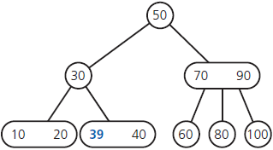
Adding Data to a 2-3 Tree (1 of 11)
Figure 19-11 After inserting 39 into the tree in Figure 19-9b (see slide 21)

Slide 24
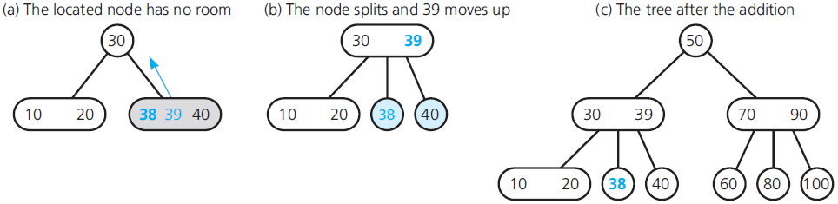
Adding Data to a 2-3 Tree (2 of 11)
Figure 19-12 The steps for adding 38 to the tree in Figure 19-11

Slide 25
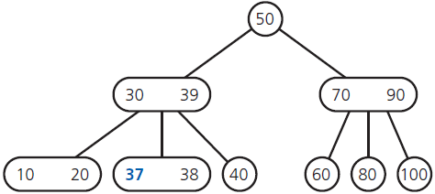
Adding Data to a 2-3 Tree (3 of 11)
Figure 19-13 After adding 37 to the tree in Figure 19-12c

Slide 26
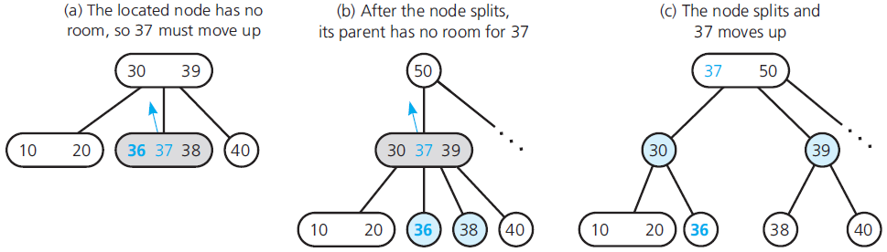
Adding Data to a 2-3 Tree (4 of 11)
Figure 19-14 The steps for adding 36 to the tree in Figure 19-13

Slide 27
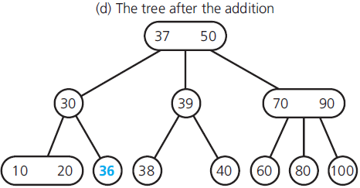
Adding Data to a 2-3 Tree (5 of 11)
Figure 19-14 [Continued]

Slide 28
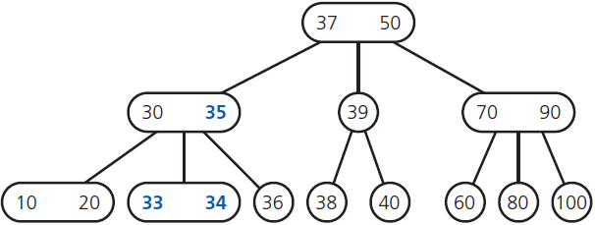
Adding Data to a 2-3 Tree (6 of 11)
Figure 19-15 The tree after the adding 35, 34, and 33 to the tree in Figure 19-14d

Slide 29
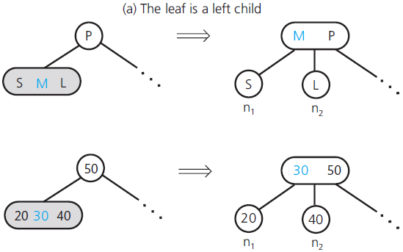
Adding Data to a 2-3 Tree (7 of 11)
Figure 19-16 Splitting a leaf in a 2-3 tree in general and in a specific example

Slide 30
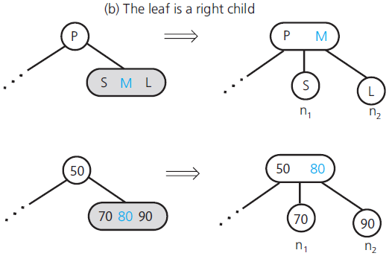
Adding Data to a 2-3 Tree (8 of 11)
Figure 19-16 [Continued]

Slide 31
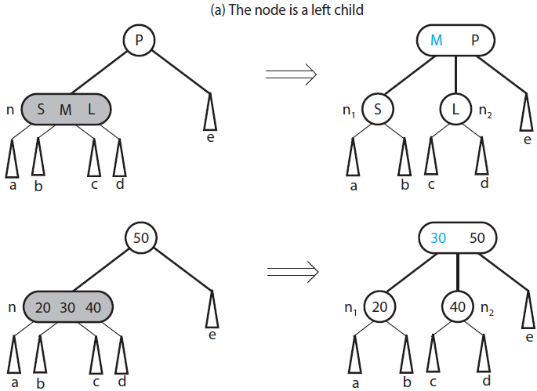
Adding Data to a 2-3 Tree (9 of 11)
Figure 19-17 Splitting an internal node in a 2-3 tree in general and in a specific example

Slide 32
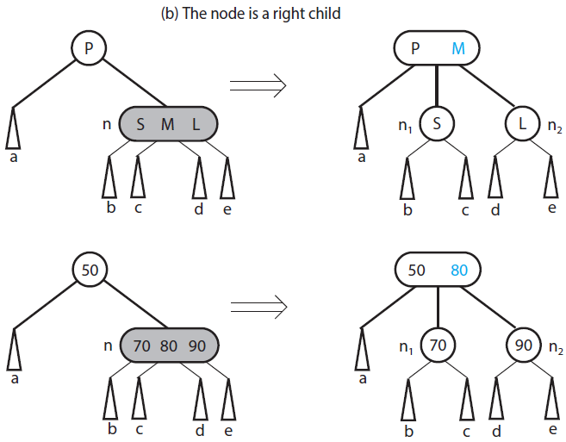
Adding Data to a 2-3 Tree (10 of 11)
Figure 19-17 [Continued]

Slide 33
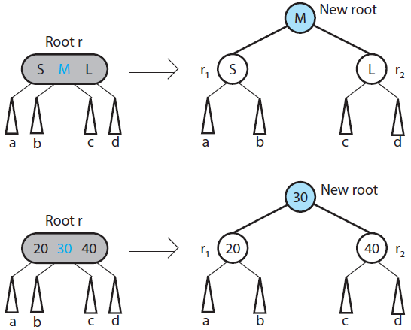
Adding Data to a 2-3 Tree (11 of 11)
Figure 19-18 Splitting the root of a 2-3 tree general and in a specific example

Slide 34
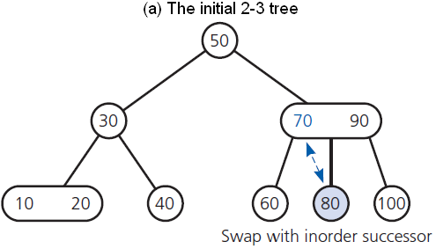
Removing Data from a 2-3 Tree (1 of 13)
Figure 19-19 The steps for removing 70 from the 2-3 tree in Figure 19-9b (see slide 21)

Slide 35
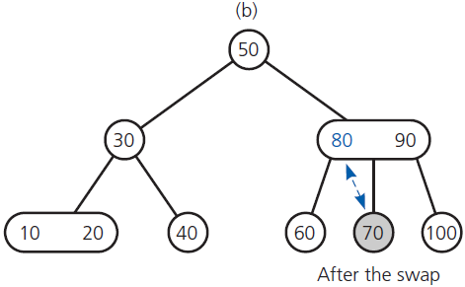
Removing Data from a 2-3 Tree (2 of 13)
Figure 19-19 [Continued]

Slide 36
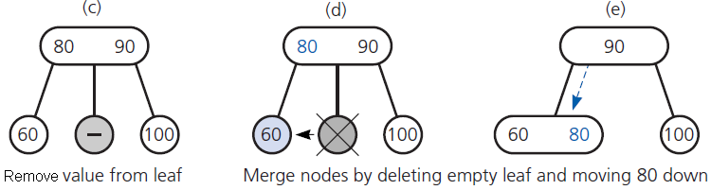
Removing Data from a 2-3 Tree (3 of 13)
Figure 19-19 [Continued]

Slide 37
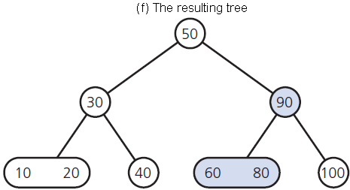
Removing Data from a 2-3 Tree (4 of 13)
Figure 19-19 [Continued]

Slide 38
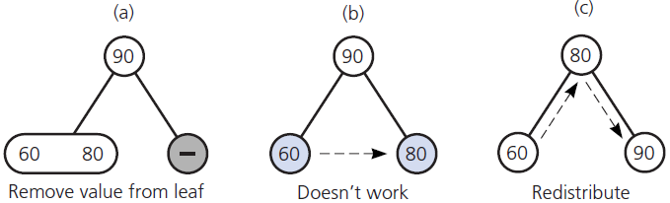
Removing Data from a 2-3 Tree (5 of 13)
Figure 19-20 The steps for removing 100 from the tree in Figure 19-19f;

Slide 39
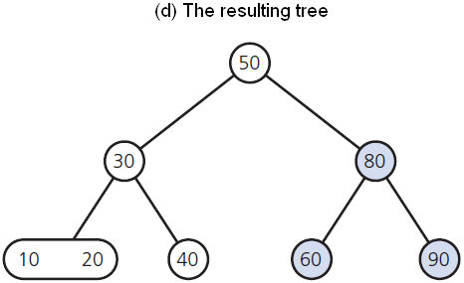
Removing Data from a 2-3 Tree (6 of 13)
Figure 19-20 [Continued]

Slide 40
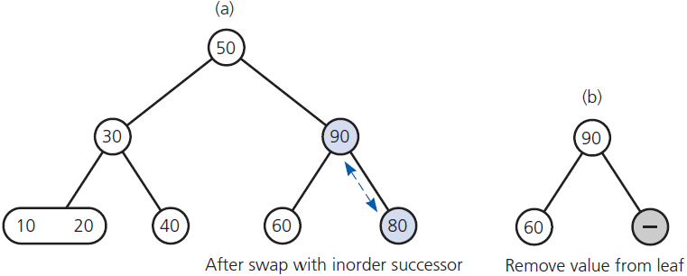
Removing Data from a 2-3 Tree (7 of 13)
Figure 19-21 The steps for removing 80 from the 2-3 tree in Figure 19-20d

Slide 41
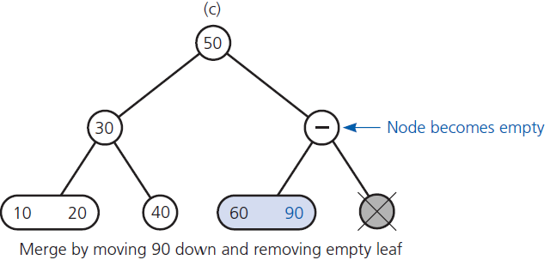
Removing Data from a 2-3 Tree (8 of 13)
Figure 19-21 [Continued]

Slide 42
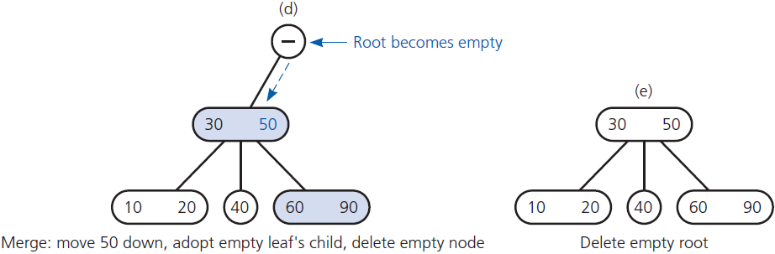
Removing Data from a 2-3 Tree (9 of 13)
Figure 19-21 [Continued]

Slide 43
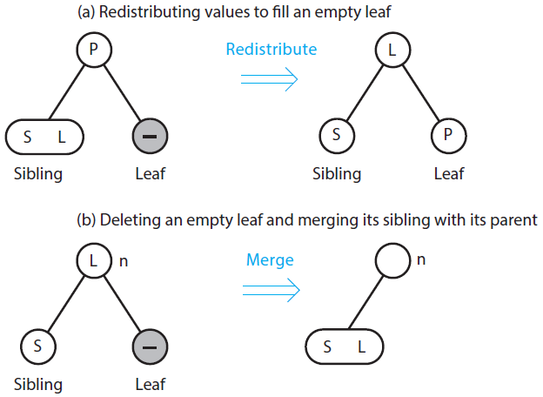
Removing Data from a 2-3 Tree (10 of 13)
Figure 19-23 Possible situations during the removal of a data item from a 2-3 tree

Slide 44
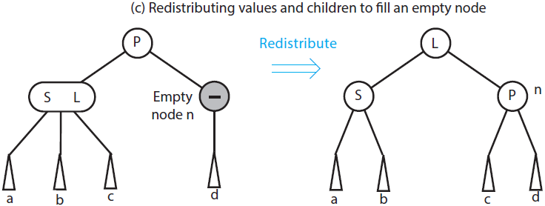
Removing Data from a 2-3 Tree (11 of 13)
Figure 19-23 [Continued]

Slide 45
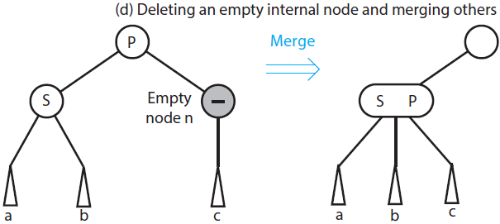
Removing Data from a 2-3 Tree (12 of 13)
Figure 19-23 [Continued]

Slide 46
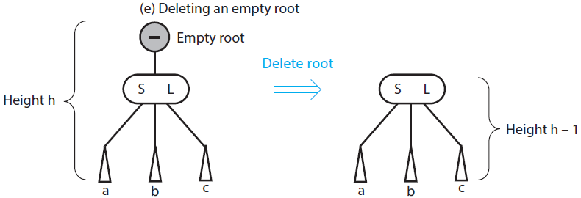
Removing Data from a 2-3 Tree (13 of 13)
Figure 19-23 [Continued]

Slide 47
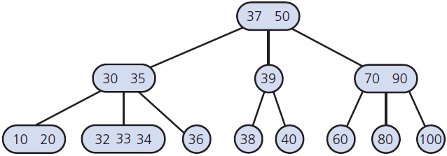
2-3-4 Trees (1 of 3)
Figure 19-24 A 2-3-4 tree with the same data items as the 2-3 tree in Figure 19-10b (see slide 22)

Slide 48
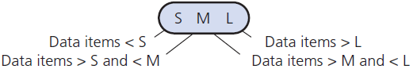
2-3-4 Trees (2 of 3)
Figure 19-25 A 4-node in a 2-3-4 tree

Slide 49
2-3-4 Trees (3 of 3)
Searching and traversing
Simple extensions of corresponding algorithms for a 2-3 tree
Adding data
Like addition algorithm for 2-3 tree
Splits node by moving one data item up to parent node

Slide 50
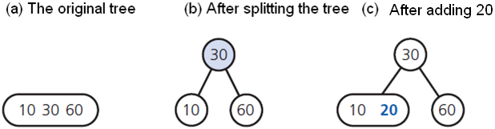
Adding Data to 2-3-4 Trees (1 of 11)
Figure 19-26 Adding 20 to a one-node 2-3-4 tree

Slide 51
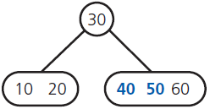
Adding Data to 2-3-4 Trees (2 of 11)
Figure 19-27 After adding 50 and 40 to the tree in Figure 19-26c

Slide 52
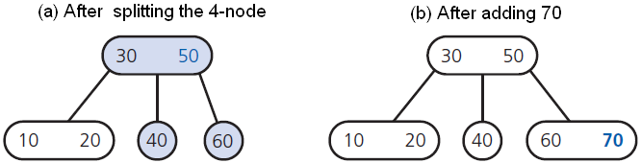
Adding Data to 2-3-4 Trees (3 of 11)
Figure 19-28 The steps for adding 70 to the tree in Figure 19-27

Slide 53
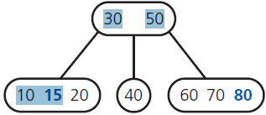
Adding Data to 2-3-4 Trees (4 of 11)
Figure 19-29 After adding 80 and 15 to the tree in Figure 19-28b

Slide 54
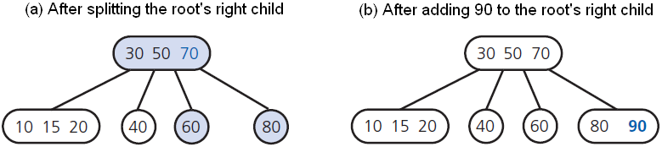
Adding Data to 2-3-4 Trees (5 of 11)
Figure 19-30 The steps for adding 90 to the tree in Figure 19-29

Slide 55

Adding Data to 2-3-4 Trees (6 of 11)
Figure 19-31 The steps for adding 100 to the tree in Figure 30b

Slide 56

Adding Data to 2-3-4 Trees (7 of 11)
Figure 19-32 Splitting a 4-node root when adding data to a 2-3-4 tree

Slide 57

Adding Data to 2-3-4 Trees (8 of 11)
Figure 19-33 Splitting a 4-node whose parent is a 2-node when adding data to a 2-3-4 tree

Slide 58

Adding Data to 2-3-4 Trees (9 of 11)
Figure 19-34 Splitting a 4-node whose parent is a 3-node when adding data to a 2-3-4 tree

Slide 59

Adding Data to 2-3-4 Trees (10 of 11)
Figure 19-34 [Continued]

Slide 60

Adding Data to 2-3-4 Trees (11 of 11)
Figure 19-34 [Continued]

Slide 61
Removing Data from a 2-3-4 Tree
Has same beginning as removal algorithm for a 2-3 tree
Transform each 2-node into a 3-node or a 4-node
Insertion and removal algorithms for 2-3-4 tree require fewer steps than for 2-3 tree

Slide 62
Red-Black Trees (1 of 3)
A 2-3-4 tree requires more storage than binary search tree
Red-black tree has advantages of a 2-3-4 tree but requires less storage
In a red-black tree,
Red pointers link 2-nodes that now contain values that were in a 3-node or a 4-node.

Slide 63

Red-Black Trees (2 of 3)
Figure 19-35 Red-black representations of a 4-node and a 3-node

Slide 64

Red-Black Trees (3 of 3)
Figure 19-36 A red-black tree that represents the 2-3-4 tree in Figure 19-24 (see slide 47)

Slide 65
Searching and Traversing a Red-Black Tree
A red-black tree is a binary search tree
Thus, search and traversal
Use algorithms for binary search tree
Simply ignore color of pointers

Slide 66
Adding to and Removing from a Red-Black Tree (1 of 7)
Red-black tree represents a 2-3-4 tree
Simply adjust 2-3-4 addition algorithms
Accommodate red-black representation
Splitting equivalent of a 4-node requires simple color changes
Pointer changes called rotations result in a shorter tree

Slide 67

Adding to and Removing from a Red-Black Tree (2 of 7)
Figure 19-37 Splitting a red-black representation of a 4-node root

Slide 68

Adding to and Removing from a Red-Black Tree (3 of 7)
Figure 19-38 Splitting a red-black representation of a 4-node whose parent is a 2-node

Slide 69

Adding to and Removing from a Red-Black Tree (4 of 7)
Figure 19-38 [Continued]

Slide 70

Adding to and Removing from a Red-Black Tree (5 of 7)
Figure 19-39 Splitting a red-black representation of a 4-node whose parent is a 3-node

Slide 71

Adding to and Removing from a Red-Black Tree (6 of 7)
Figure 19-39 [Continued]

Slide 72

Adding to and Removing from a Red-Black Tree (7 of 7)
Figure 19-39 [Continued]

Slide 73

Copyright

